Slide 1
PARALLEL TESTING (SELENIUM JAVA + TESTNG)
ANJANA P (11265)

Slide 2
TESTNG
TestNG is an automation testing framework
NG stands for “Next Generation”.
TestNG is inspired by JUnit which uses the annotations (@).
TestNG overcomes the disadvantages of JUnit and is designed to make end-to-end testing easy.
Using TestNG, you can generate a proper report, and you can easily come to know how many test cases are passed, failed, and skipped.
You can execute the failed test cases separately.

Slide 3
SELENIUM
It is a open source testing tool.
It is used for automating web application.
Selenium framework is a suite of automation testing tools based on the javascript framework.
Selenium is a suite of software tools
It allows developers and testers to automate the testing of web applications across different browers and platforms.

Slide 4
PARALLEL EXECUTION
Parallel testing is a process where multiple tests are executed simultaneously/in parallel in different thread processes with respect to Selenium and TestNG
It allows you to execute multiple tests on different browsers, devices, environments in parallel and at the same time, instead of running it sequentially.
The main purpose of running tests in parallel mode is to reduce execution time and do maximum environment coverage (browsers/devices/environment) in less time.

Slide 5
FOR EXAMPLE:
If you go with the traditional sequential flow, you need to execute the suite for Demo Web Shop browser first which would take 1 hr and then you need to execute for Flipkart browser which takes another 1 hr and then you need to execute for Shopsy browser which takes another 1hr.
So, in total you would need 3 hrs to test in both the browsers.
By using a parallel mechanism, you can run simultaneously the browsers in just 1 hr thereby reducing the execution time by 50%

Slide 6
HOW TO PERFORM PARALLEL EXECUTION IN TESTNG
parallel testing must be used with the test case methods to run them in parallel TestNG .
parallel testing accepts the following keywords (values) in TestNG.
Parallel test execution in TestNG triggers with the help of keyword "parallel"
Methods: This will run the parallel tests on all @Test methods in TestNG.
Tests: All the test cases present inside the <test> tag will run with this value.
Classes: All the test cases present inside the classes that exist in the XML will run in parallel.
Thread-count: This is used for parallel execution, based on the number script. It will execute in parallel or sequential order.

Slide 7
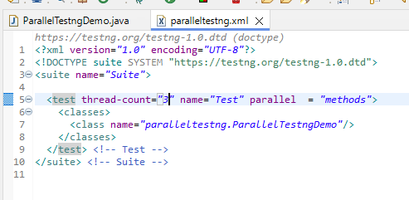
Testng.Xml File

Slide 8
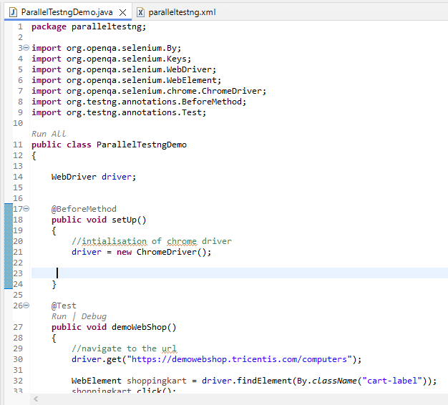
Selenium Code

Slide 9
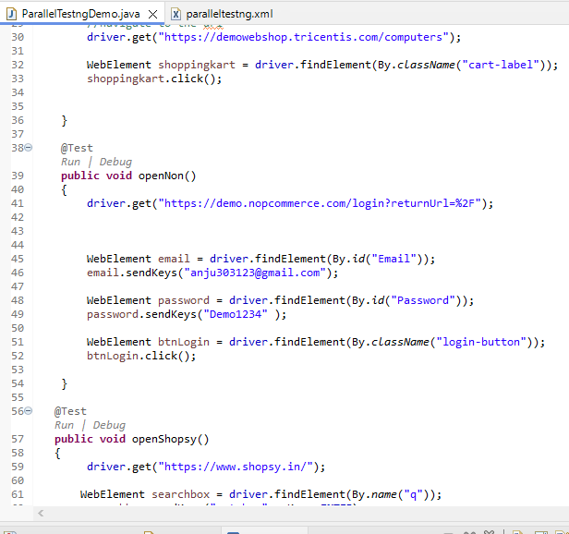

Slide 10
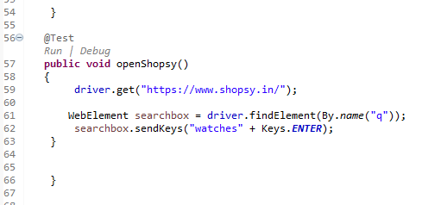

Slide 11
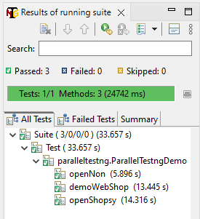
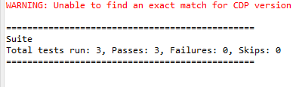
Output

Slide 12
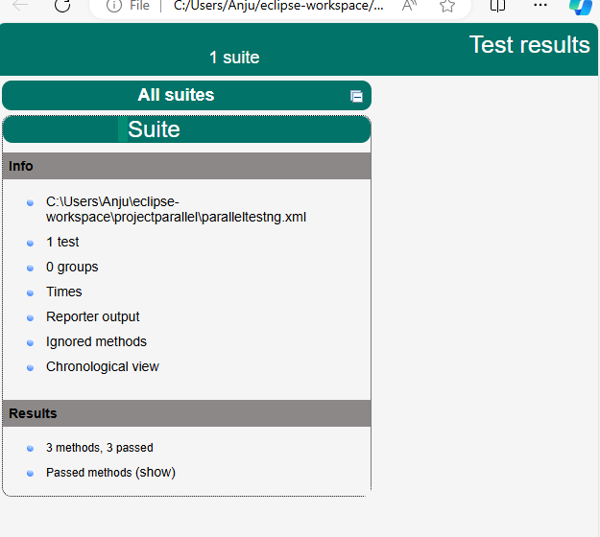
Report

Slide 13
ADVANTAGES OF PARALLEL TESTING
Reduces Time: Running the tests in parallel reduces the overall execution time.
Allow Multi-Threaded Tests: Using the parallel execution in TestNG, we can allow multiple threads to run simultaneously on the test case providing independence in the execution of different components of the software.
Improved efficiency: Parallel testing maximizes resource utilization by distributing tests across multiple machines, threads, or processes. It improving testing efficiency.
Early bug detection: Running tests in parallel allows for faster detection of bugs and issues. Defects can be identified and addressed earlier in the development cycle, leading to faster resolution and reduced overall costs.
We are just organizing the execution by the use of annotation.

Slide 14
DISADVANTAGES OF PARALLEL TESTING
Fails On Dependent Modules : Most of the times the tests are inter-dependent, hence failing chances are more.
Program Flow Sequence : The tester should be well aware of the program flow to create parallel testing modules. Testers need to know which modules must run simultaneously and which modules must follow a pattern to ensure proper operation.

Slide 15
Conclusion
Parallel execution allows multiple tests to run simultaneously, reducing the total execution time and improves test efficiency.
. It allows you to run multiple tests concurrently on different browsers, devices, or environments instead of running them sequentially
Resource Optimization: You can make better use of your hardware resources, as multiple tests can run concurrently on different threads or even on different machines.
Each test runs independently, utilizing separate browser instances or devices, ensuring that tests do not interfere.

Slide 16


